Slide 1

A user’s guide to user authentication
Presented by: Christina Nguyen, Michael Bloomquist, Sarah Ramazani, Travis Lamb

Slide 2
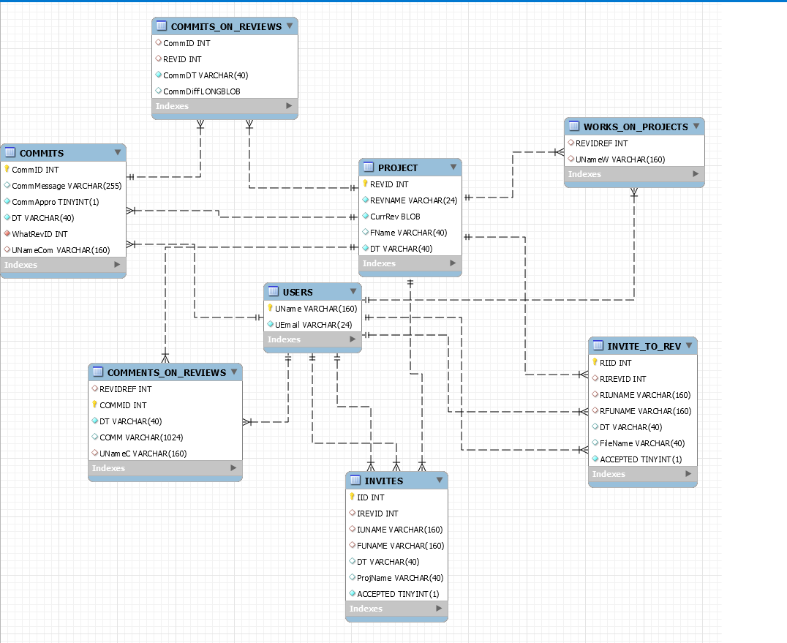
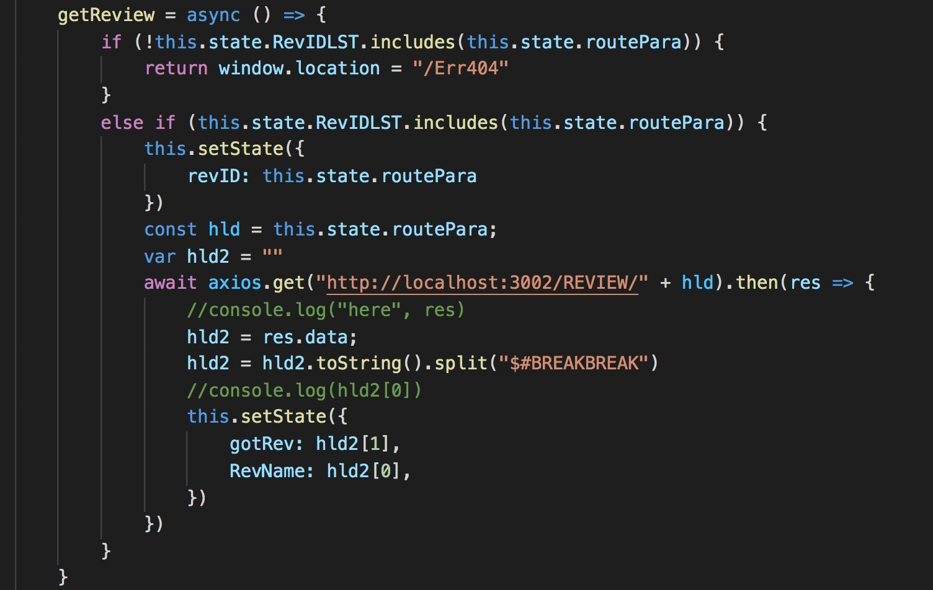
Database Retrieval
Database Design
User Information
Code Diff
Project Information
Invites
Login/Registration

Slide 3
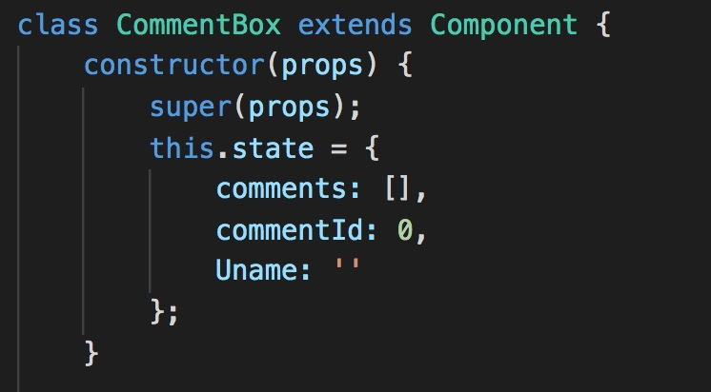
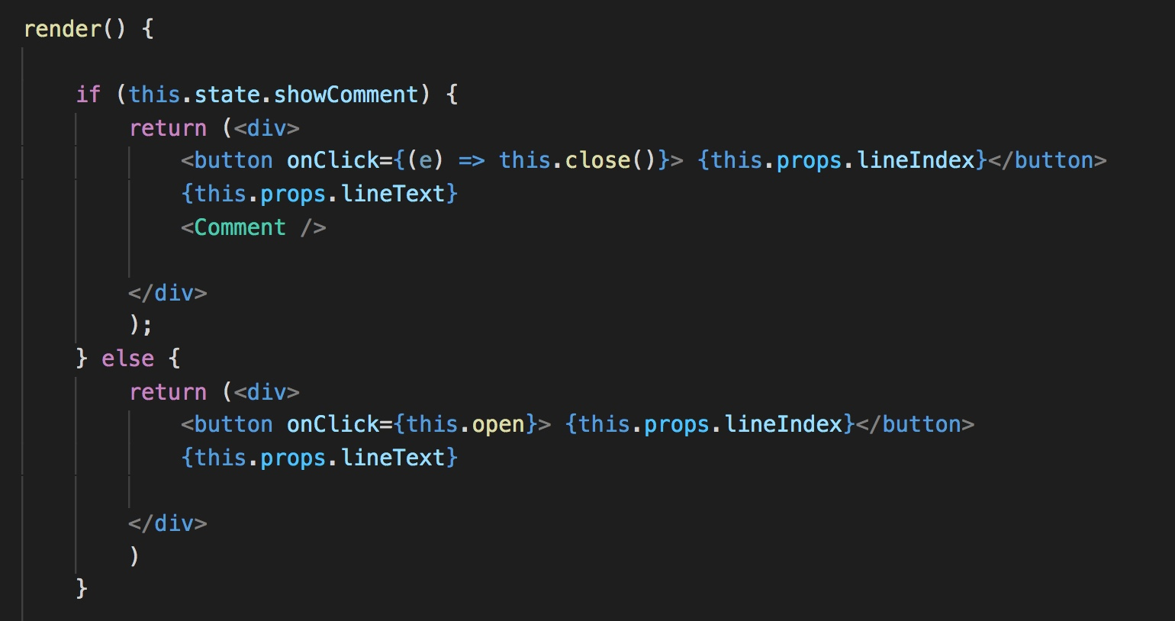
Inline Commenting
Comment box component
Separated by Line and Index
Specific line of Code

Slide 4
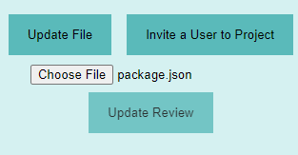
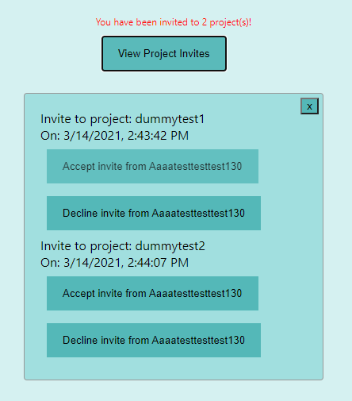
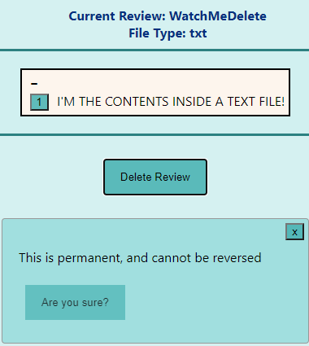
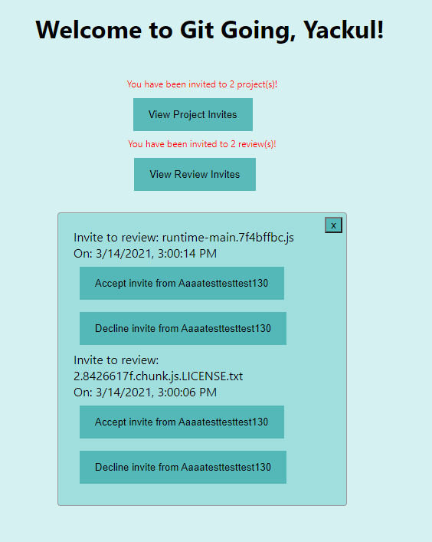
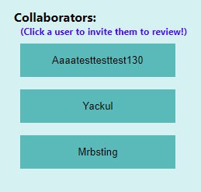




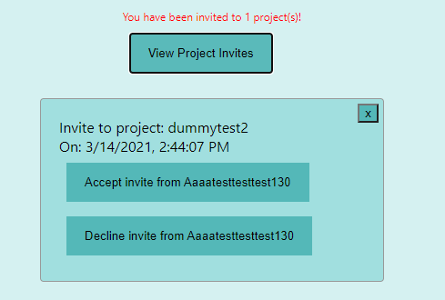
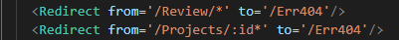



Git Going
--Where we’re at today.
Concurrent User Projects
A new file is selected
Each project has a unique ID associated with it. This unique ID is used to create URL paths for our router to correctly display the relevant project page
Informative Notifications
Collaborator Invites
Any number of projects are supported by this routing method, giving truly dynamic routing to user specific content.
And the database is updated!
Project Deletion
File Updates
A lot works together to get this done. The following are small parts of much larger functions, but they are what makes it all tie together.
Here the blob is the file, and some other vital information is held!
Dynamic Routing
It even works when redirecting users to pages that don’t exist!
Here’s a small example of how this is achieved!
Here’s an example of the private/public key state that our DB API uses to authenticates requests! You’ll hear about this more later.

Slide 5
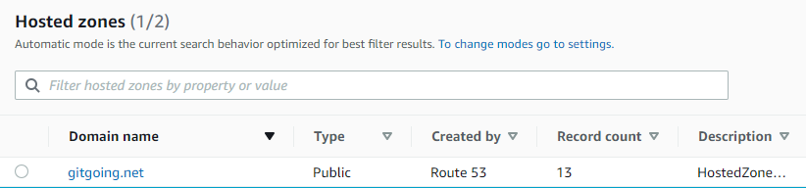
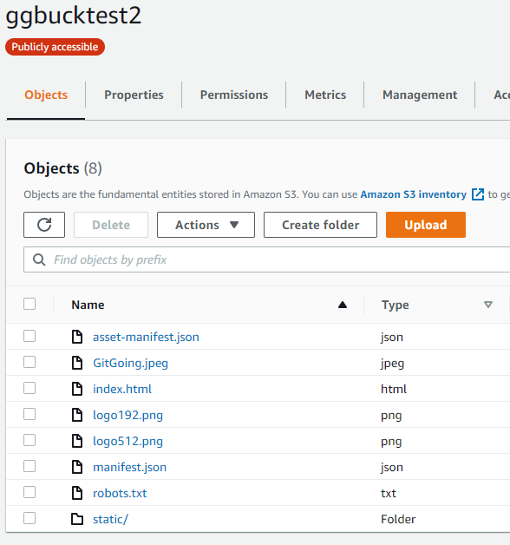
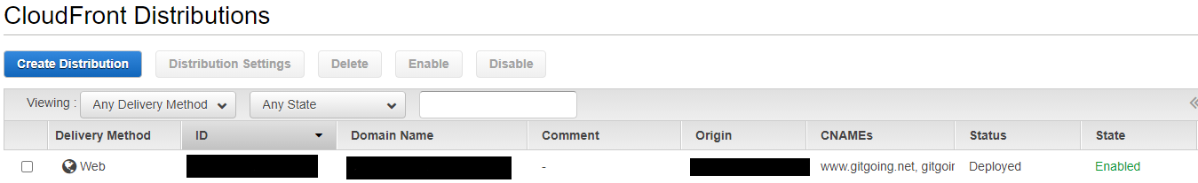
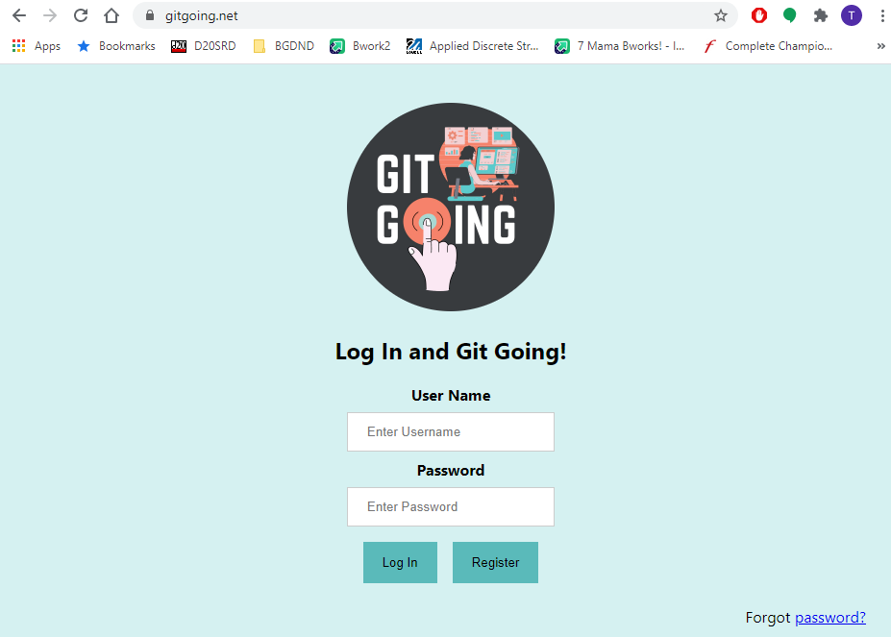
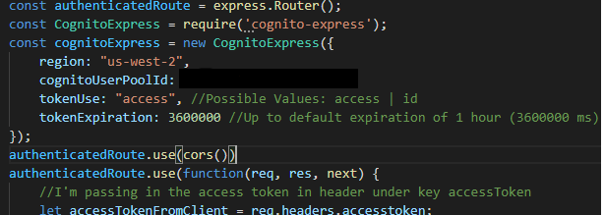
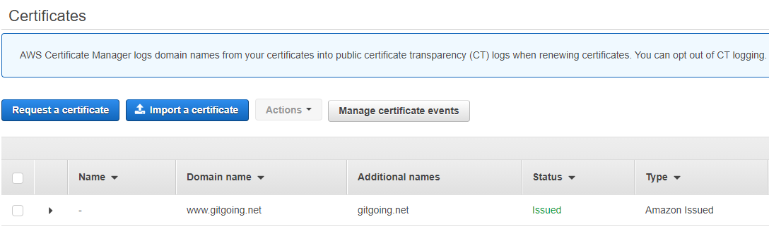
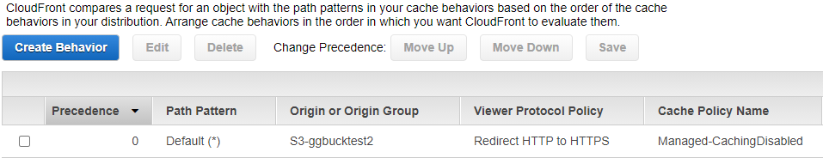
Git Going
--Some other neat stuff.
Despite the name, this is no simple test run.
Live & Fully Usable Alpha Build
Route 53
Simple Storage Service (S3)
CloudFront
Node.JS Cognito AUTH
*In a finished build, caching can be enabled

Slide 6

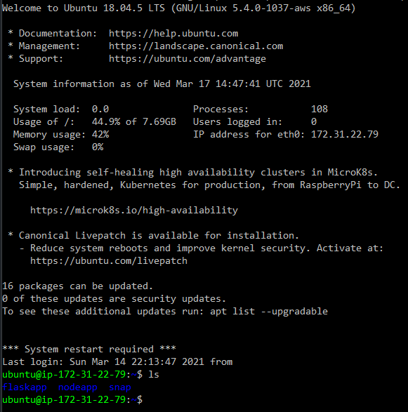



Backend Options
Flask and Nodejs apps hosted on an EC2 instance (or other server)
For diff operations
Need somewhere to run the flask and nodejs apps
+
AWS Lambda + Amazon Elastic File System
For database operations
Run the apps on a server (virtual machine, physical server, etc.)

Slide 7
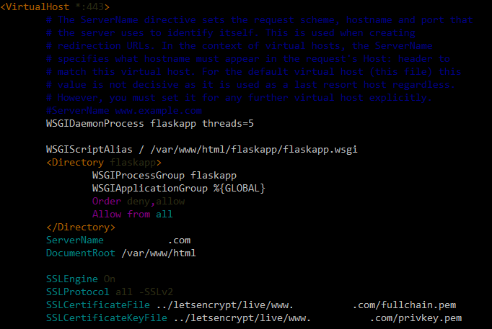
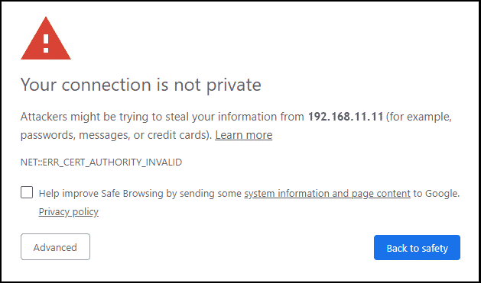
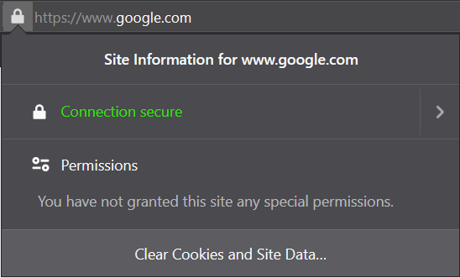
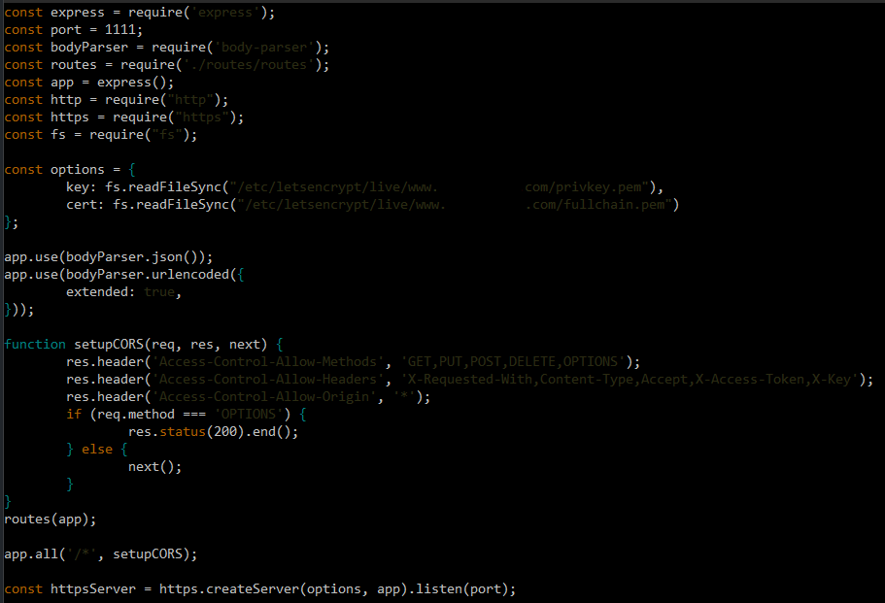
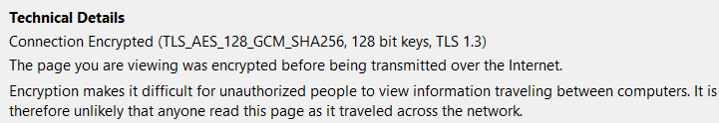
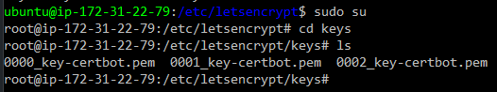
HTTPS and TLS
What is TLS? (Transport Layer Security, previously known as SSL or Secure Sockets Layer)
TLS Certificates (Self-signed vs. CA issued)
Now that we have a valid certificate …

Slide 8
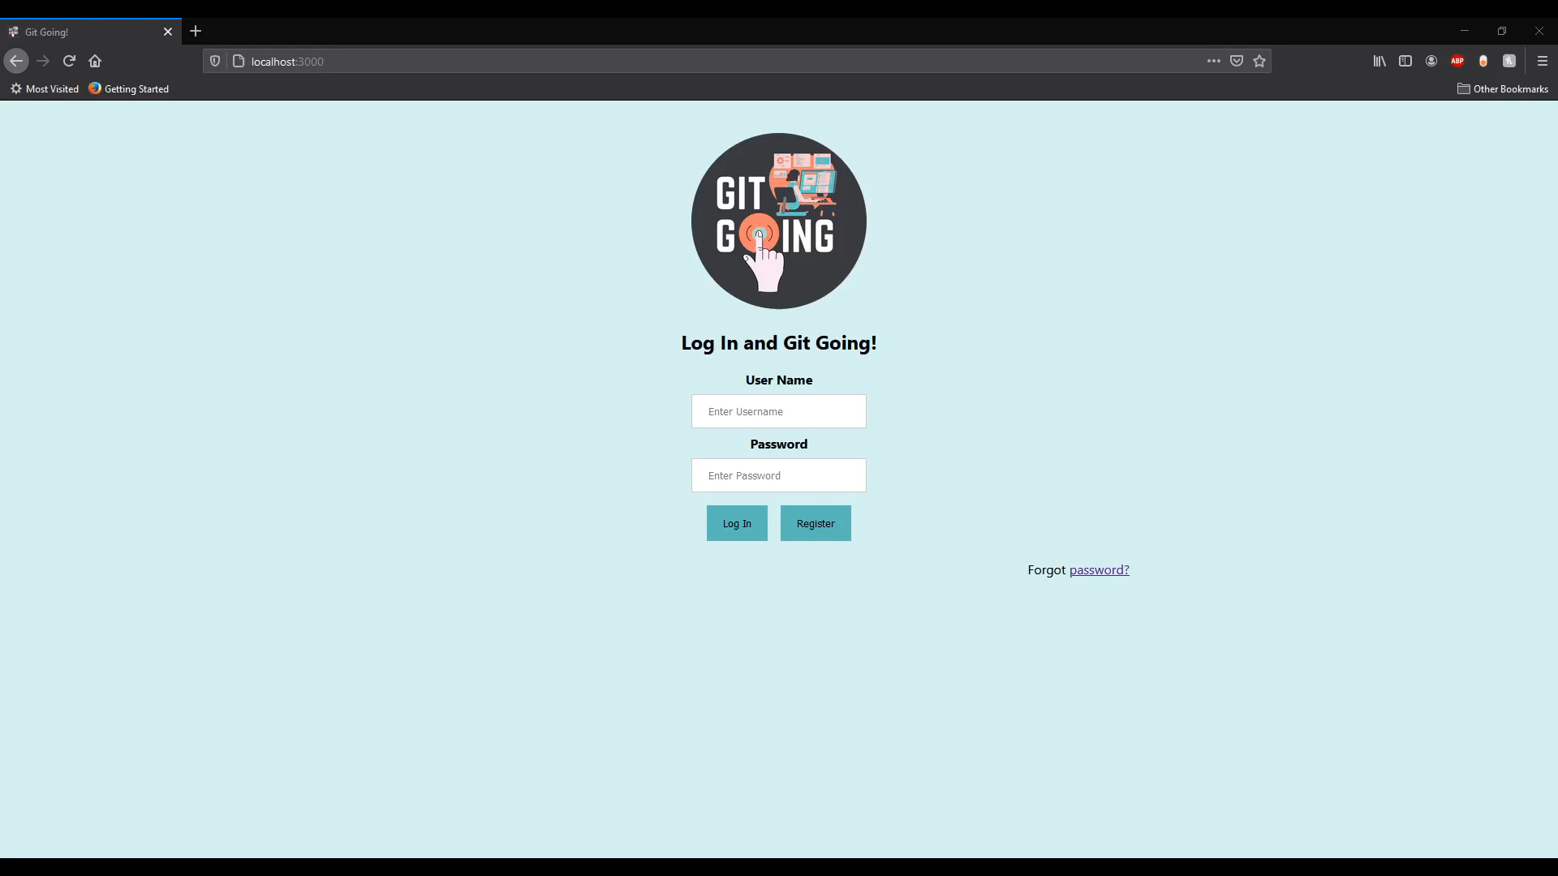
CODE REVIEW PROCESS Demonstration

Slide 9

The Road Ahead
Implementation of file history for projects
Automatic retrieval of diffs when a file is updated
Implementation of the approval/rejection system for reviews
Expansion of inline commenting
Message system for users

